Slide 1
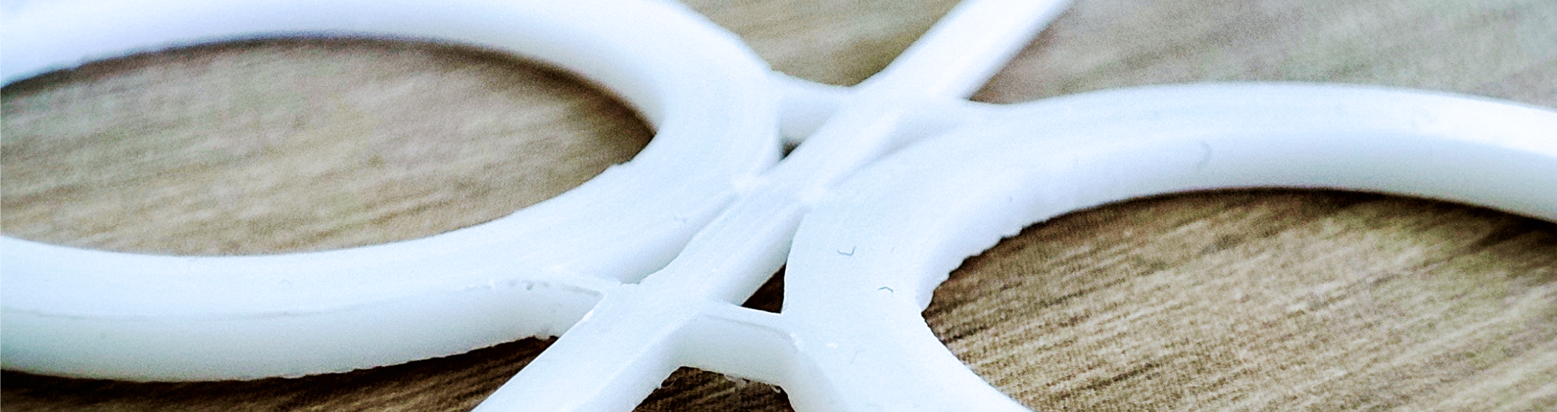



A mmWave Phase Correlation Based Gas Velocity Sensor Utilizing
Time Domain Multiplexed Fixed Target Radar Measurements
¹Dr.-Ing. Christoph Baer, ²Dr.-Ing. Timo Jaeschke
¹Institute of Electronic Circuits, Ruhr University Bochum
² 2π-Labs GmbH, Germany
ICEAA 2024
04/09/24 Lisbon, Portugal

Slide 2
Overview
Motivation
Sensor Concept
Design and Simulation
Measurement Results
Conclusion

Slide 3
Overview
Motivation
Sensor Concept
Design and Simulation
Measurement Results
Conclusion

Slide 4
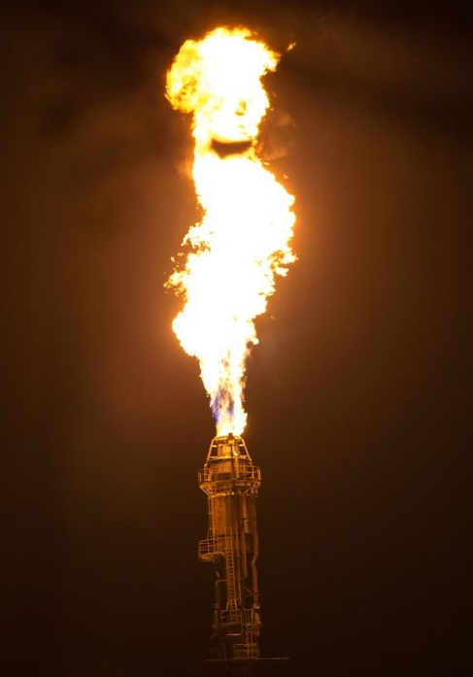
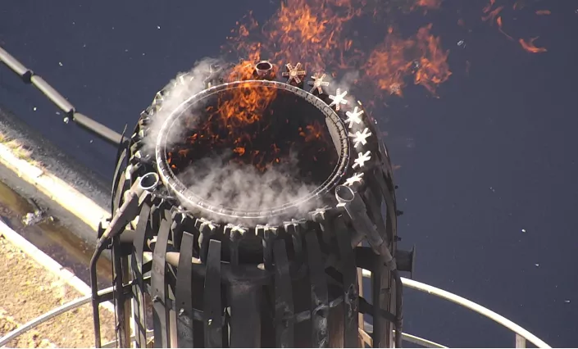

Motivation
Surveillance of safety installations – Gas velocity measurement
Flare stacks:
Application areas: refineries, chemical plants, gas processing etc.
Important safety device in case of unplanned over-pressuring
Burning of waste gases
Enormous noise and light pollution of environment
Source: https://www.lalineavertical.com/
Chempark Litvinov
source: www.freiepresse.de
Chempark Litvinov
source: www.freiepresse.de
Notes:
In total 10 253 victims

Slide 5
Motivation
Surveillance of safety installations – Gas velocity measurement
Control of flare stacks:
Reduction of light emission by steam injection
Required knowledge for controlling:
Mean gas flow velocity
Measurement Conditions:
Flow velocities 0.2 m/s up to 120 m/s
Flare pipe diameter: 20 cm up to 2m
Turbulent flow regime
Challenging Measurement
Wide measurement range
No sensors allowed inside of the pipe
No microwave reflecting particles
Contact free measurement, no Doppler measurements possible
steam
Notes:
In total 10 253 victims

Slide 6
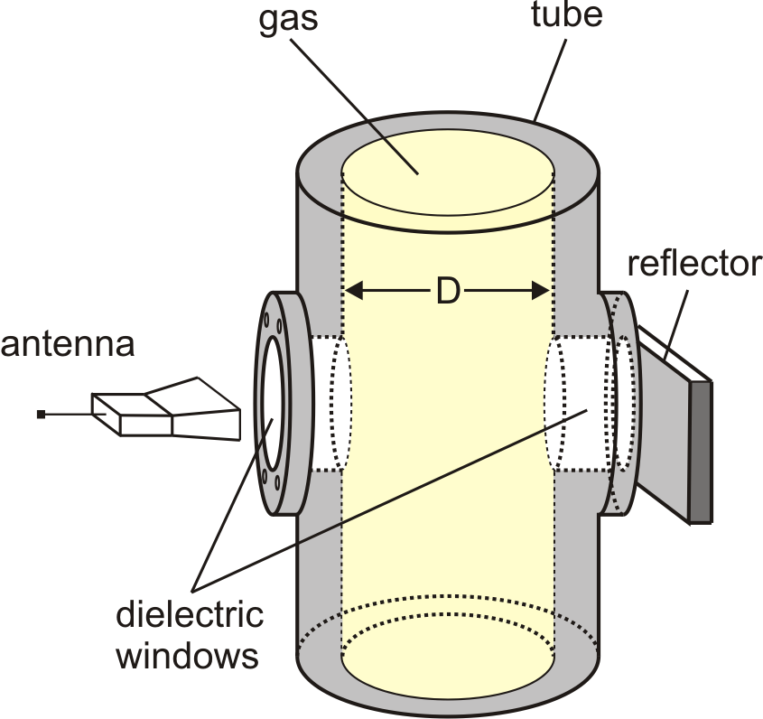
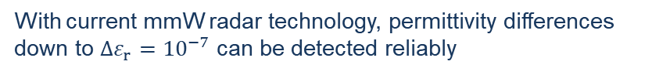
Motivation
Microwave correlation approach – State of the art and research
Fixed Target Radar approach
TOF of a double transmitted signal shows reflector position:
Phase change is a very sensitive indicator for
small permittivity changes
radar
With current mmW radar technology, permittivity differences down to $Δε_{r}={10}^{−7}$ can be detected reliably
Published: C. Baer, et al, "Contactless Detection of State Parameter Fluctuations of Gaseous Media Based on an mm-Wave FMCW Radar,"
in IEEE Transactions on Instrumentation and Measurement, vol. 64, no. 4, pp. 865-872, April 2015,
Notes:
In total 10 253 victims

Slide 7
Motivation
Microwave correlation approach – State of the art and research
Correlation based velocity measurement
Velocity Determination:
Adding second measuring port
Recording the „Radar“ history
Two port cross correlation shows possible time delays:
Highest correlation factor implies time delay of flow
Velocity depends on distance L:
Radar
L
Correlator
Radar
L
L = distance between ports, i = index of max. corr. factor, T = sampling time
Published: C. Baer, et al, "A mmWave Measuring Procedure for Mass Flow Monitoring of Pneumatic Conveyed Bulk Materials,“
in IEEE Sensors Journal, vol. 14, no. 9, pp. 3201-3209, Sept. 2014,
Notes:
In total 10 253 victims

Slide 8
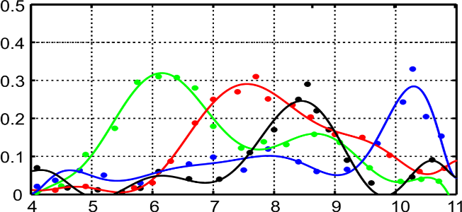
Motivation
Microwave correlation approach – State of the art and research
Correlation based velocity measurement
Velocity Determination:
Adding second measuring port
Recording the „Radar“ history
Two port cross correlation shows possible time delays:
Highest correlation factor implies time delay of flow
Velocity depends on distance L:
v_{set} =6.33 m/s
v_{set} =7.59 m/s
v_{set} =8.52 m/s
v_{set} = 10.14 m/s
r_{xy}
v_{meas} in m/s
Maximum measurement error of 1.8%
L = distance between ports, i = index of max. corr. factor, T = sampling time
Published: C. Baer, et al, "A mmWave Measuring Procedure for Mass Flow Monitoring of Pneumatic Conveyed Bulk Materials,“
in IEEE Sensors Journal, vol. 14, no. 9, pp. 3201-3209, Sept. 2014,
Notes:
In total 10 253 victims

Slide 9
Motivation
Microwave correlation approach – State of the art and research
Correlation based velocity measurement
Velocity Determination:
Adding second measuring port
Recording the „Radar“ history
Two port cross correlation shows possible time delays:
Highest correlation factor implies time delay of flow
Velocity depends on distance L:
v_{set} =6.33 m/s
v_{set} =7.59 m/s
Drawbacks of sensor concept:
At least 2 radar systems necessary
Radar systems must measure highly synchronous at a very high measurement rate
v_{set} =8.52 m/s
v_{set} = 10.14 m/s
r_{xy}
v_{meas} in m/s
L = distance between ports, i = index of max. corr. factor, T = sampling time
Published: C. Baer, et al, "A mmWave Measuring Procedure for Mass Flow Monitoring of Pneumatic Conveyed Bulk Materials,“
in IEEE Sensors Journal, vol. 14, no. 9, pp. 3201-3209, Sept. 2014,
Notes:
In total 10 253 victims

Slide 10
Overview
Motivation
Sensor Concept
Design and Simulation
Measurement Results
Conclusion

Slide 11
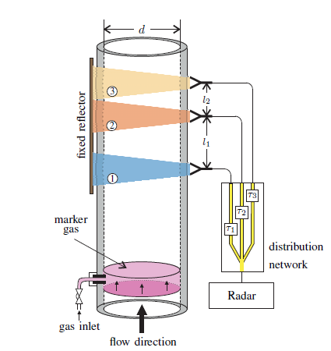
Sensor Concept
Time Domain Multiplex Radar Approach - TDMRA
Novel Concept
Introduction of a signal distribution network:
Signal distribution to different meas. channels
Inserting different time delays for meas. channels
Utilization of a single radar system
Perfect synchronous measurements of the meas. Channels
Requirements to the distribution network:
Broadband transmission
Un/Equal transmission splitting
Low loss/ low dispersion
Inserted time delays must be sufficiently long for time gating
Notes:
In total 10 253 victims

Slide 12
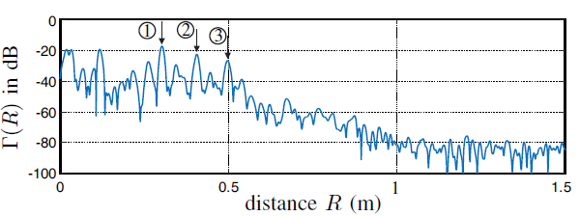
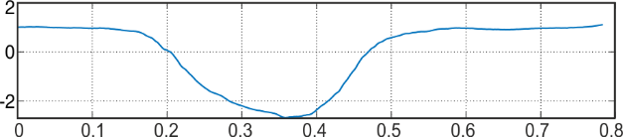
Sensor Concept
Time Domain Multiplex Radar Approach - TDMRA
Simultaneous measurement of all three channels
Time gating enables separate phase measurement
Recording of radar phase history of all 3 channels
Cross correlation between phase histories reveals flow time
Φ
time t (s)
Notes:
In total 10 253 victims

Slide 13
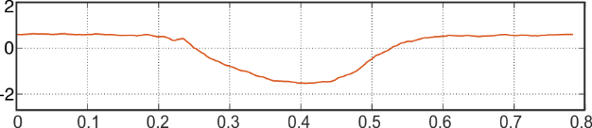
Sensor Concept
Time Domain Multiplex Radar Approach - TDMRA
Simultaneous measurement of all three channels
Time gating enables separate phase measurement
Recording of radar phase history of all 3 channels
Cross correlation between phase histories reveals flow time
Φ
time t (s)
Notes:
In total 10 253 victims

Slide 14
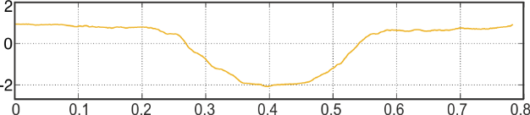
Sensor Concept
Time Domain Multiplex Radar Approach - TDMRA
Simultaneous measurement of all three channels
Time gating enables separate phase measurement
Recording of radar phase history of all 3 channels
Cross correlation between phase histories reveals flow time
Φ
time t (s)
Notes:
In total 10 253 victims

Slide 15
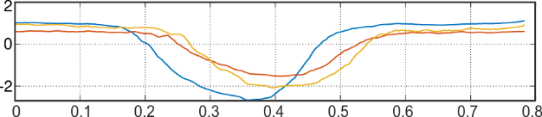
Sensor Concept
Time Domain Multiplex Radar Approach - TDMRA
Simultaneous measurement of all three channels
Time gating enables separate phase measurement
Recording of radar phase history of all 3 channels
Cross correlation between phase histories reveals flow time
Φ
time t (s)
Notes:
In total 10 253 victims

Slide 16
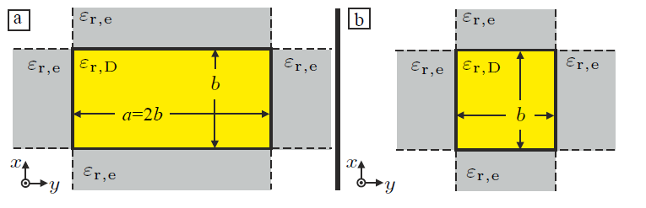
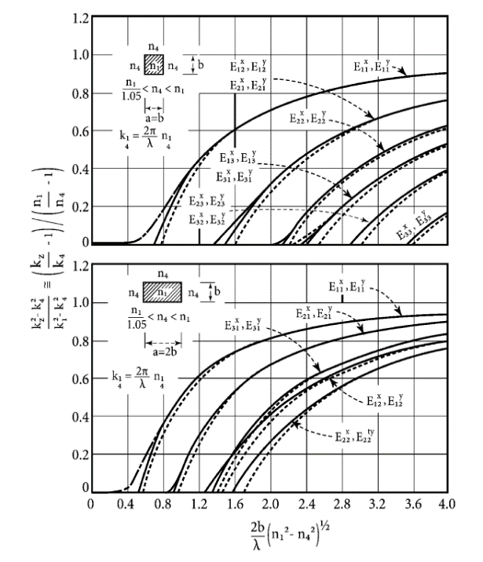
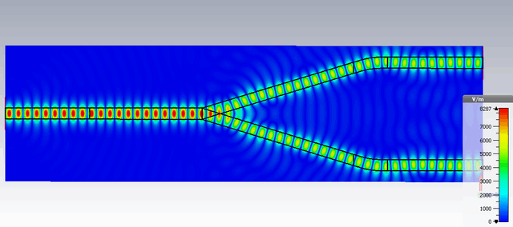
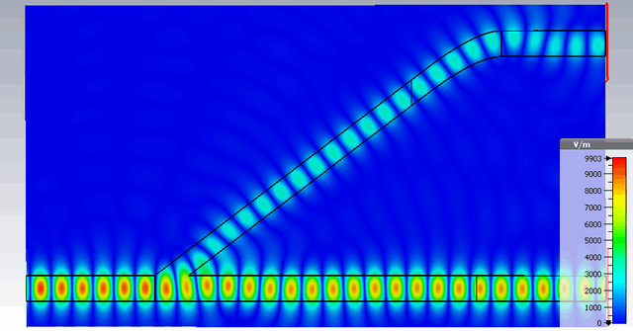
Sensor Concept
Signal Distribution Network – DWG approach
SDN difficult /costly to realize in standard PCB or waveguide technology
Operation frequency: W-band (70-90GHz)
Utlization of quadratic Dielectric Waveguides:
Low dispersion and low loss transmission
Cheap manufacturing (3D printable)
Combined SDN: Splitter, delay line, antenna
normalized phase constant
C: Yeh et al, „The essence of dielectric waveguides „
Published: C. Baer, "Broadband mmWave Splitters Based on Dielectric Waveguides,"
2019 IEEE International Symposium on Antennas and Propagation and USNC-URSI Radio Science Meeting, Atlanta, GA, USA, 2019, pp. 1727-1728

Slide 17
Overview
Motivation
Sensor Concept
Design and Simulation
Measurement Results
Conclusion

Slide 18
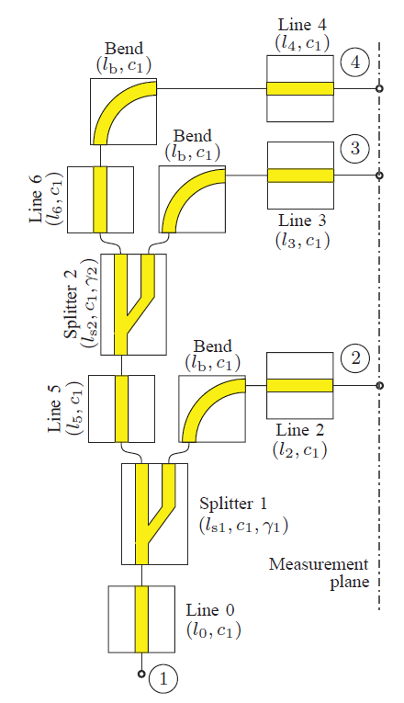
Network Design
Signal Distribution–Design Parameters
Three outputs desirable for extended measurement range
Sufficient delay for range seperation (time-gating)
Equal power distribution
γ : splitting ratio
α : line attenuation (1/m)
Notes:
In total 10 253 victims

Slide 19
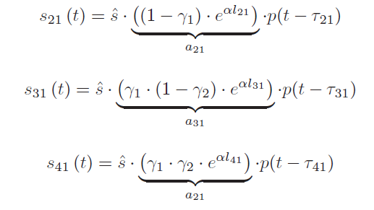
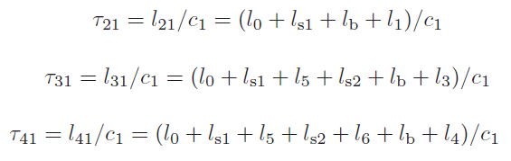
Network Design
Signal Distribution–Design Parameters
Three outputs desirable for extended measurement range
Sufficient delay for range seperation (time-gating)
Equal power distribution
Time domain signals
γ : splitting ratio
α : line attenuation (1/m)
Notes:
In total 10 253 victims

Slide 20
Network Design
Signal Distribution–Design Parameters
Three outputs desirable for extended measurement range
Sufficient delay for range seperation (time-gating)
Equal power distribution
Time domain signals
γ : splitting ratio
α : line attenuation (1/m)
Notes:
In total 10 253 victims

Slide 21
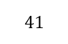
Network Design
Signal Distribution–Design Parameters
Three outputs desirable for extended measurement range
Sufficient delay for range seperation (time-gating)
Equal power distribution
Time domain signals
γ : splitting ratio
α : line attenuation (1/m)
Notes:
In total 10 253 victims

Slide 22
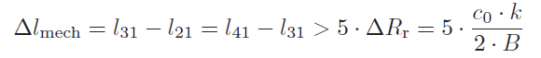
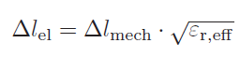
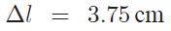
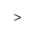
Network Design
Signal Distribution–Design Parameters
Three outputs desirable for extended measurement range
Sufficient delay for range seperation (time-gating)
Equal power distribution
Time domain signals
d
γ : splitting ratio
α : line attenuation (1/m)
Notes:
In total 10 253 victims

Slide 23
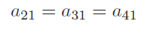
Network Design
Signal Distribution–Design Parameters
Three outputs desirable for extended measurement range
Sufficient delay for range seperation (time-gating)
Equal power distribution
Time domain signals
γ : splitting ratio
α : line attenuation (1/m)
Notes:
In total 10 253 victims

Slide 24
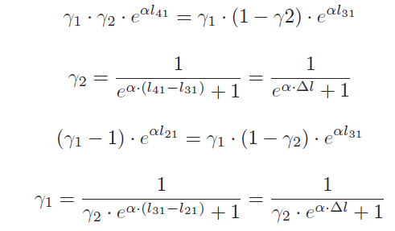
Network Design
Signal Distribution–Design Parameters
Three outputs desirable for extended measurement range
Sufficient delay for range seperation (time-gating)
Equal power distribution
γ : splitting ratio
α : line attenuation (1/m)
Notes:
In total 10 253 victims

Slide 25
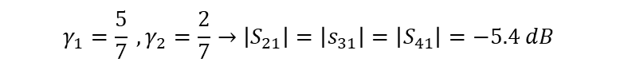
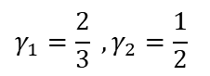
Network Design
Signal Distribution–Design Parameters
Three outputs desirable for extended measurement range
Sufficient delay for range seperation (time-gating)
Equal power distribution
Under ideal conditions:
$$γ_{1}=\frac{2}{3} , γ_{2}=\frac{1}{2}$$
Transmission line losses can be neglected:
$Δl_{d}=3.75cm→α_{db}=2⋅0.0375⋅2.4\frac{dB}{m}=0.18 dB$
But splitter provides additional losses (~1dB):
Compensation can be made with choosing optimized splitting ratio
$$γ_{1}=\frac{5}{7} , γ_{2}=\frac{2}{7}→\left|S_{21}\right|=\left|s_{31}\right|=\left|S_{41}\right|=−5.4 dB$$
γ : splitting ratio
α : line attenuation (1/m)
Notes:
In total 10 253 victims

Slide 26
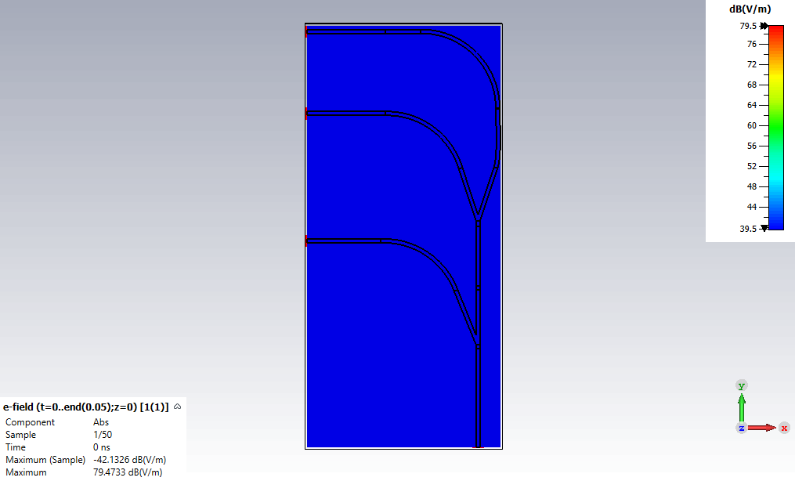
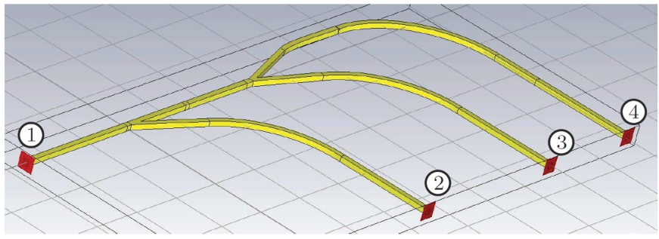
Network Design
Simulations – Time Domain E-Field
DWG: ε_{r} = 2.3, w₁ = 2 mm
Frequency: 70..90 GHz
CST Studio Suite 2023, T-Solver
Unequal splitter were adapted from [2]
Total size: 88mm x 212mm x 2mm
Notes:
In total 10 253 victims

Slide 27
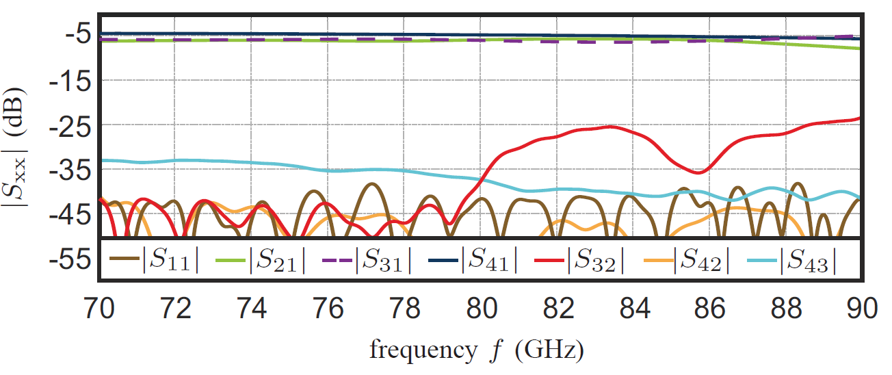
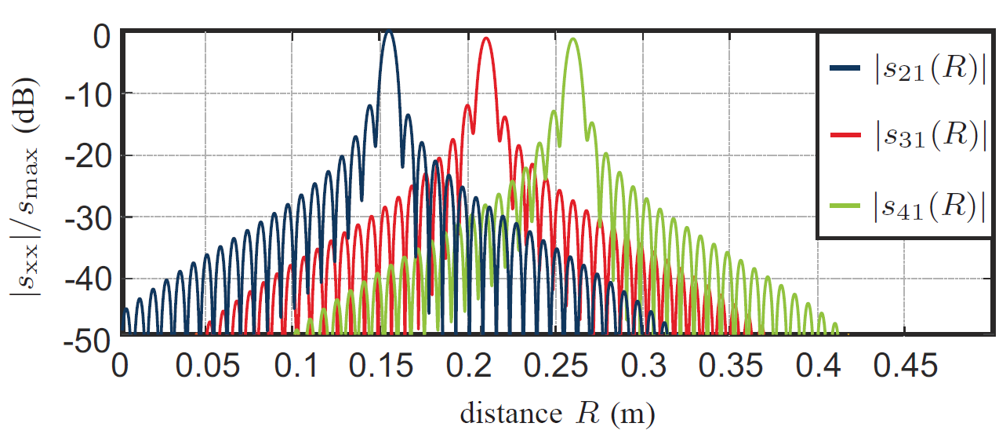
Results
Simulations – S-Parameters
DWG: ε_{r} = 2.3, w₁ = 1.8 mm
Frequency: 70..90 GHz
All ports matched better 40dB
Transmission parameters differ about 0.6dB from desired value of -5.4dB
Port decoupling better 25dB
Line differences: 5.2 cm /5.6 cm
Notes:
In total 10 253 victims

Slide 28
Overview
Motivation
Sensor Concept
Design and Simulation
Measurement Results
Conclusion

Slide 29
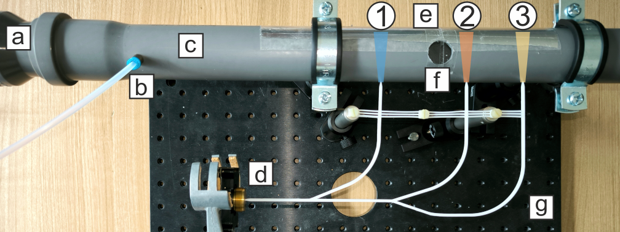
Measurement Results
Test setup
Ventilator (a): flow velocities up to 6m/s
Marker gas inlet (b):
marker gas CO2 (Phase shift~ 2°), inlet spray time: 0.5ms
Test pipe (c): PVC, 60mm diameter
mmWave FMCW radar system (d):
Frequency: 70-90GHz, Meas. Rep. frequency: 1kHz
Metal reflector (e), realized with aluminum foil
Vane rate anemometer Testo 416 as reference measurement device, measurement hole (f)
DWG (g) made of HIPS with additional holder structure
Notes:
In total 10 253 victims

Slide 30

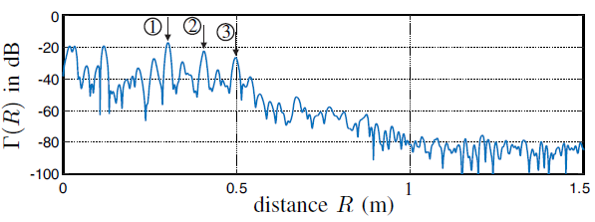
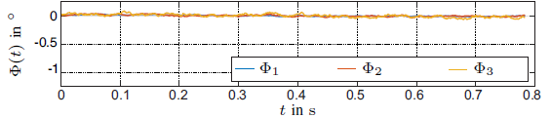
Measurement Results
Fixed Target Radar Measurement
Measurement channels 1, 2 and 3 clearly identifiable
Virtual distance between radar targets 10 cm
Geom. Distances between measurement beams:
l_{1,2} = 6.3 cm
l_{2,3} = 4.3 cm
l_{1,3} = 10.6 cm
Reference measurement (no marker, no flow), 800 measurements, rep. frequency: 1kHz
Phase std deviation of reference measurement < 0.005°
Notes:
In total 10 253 victims

Slide 31
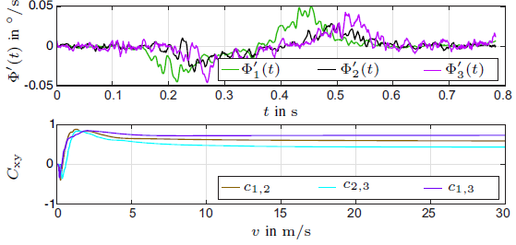
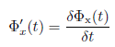
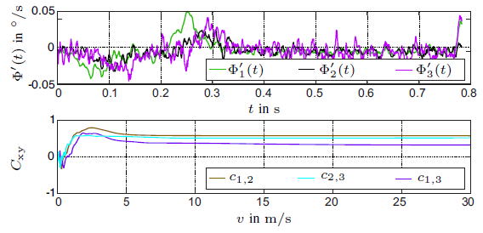
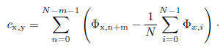
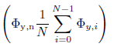
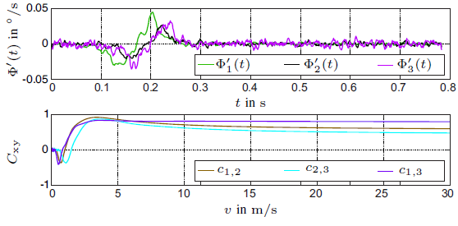
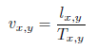
Measurement Results
Correlation Measurements
1.5 m/s
For avoiding cross correlation of offsets, usage of phase deviation
for cross correlation:
Velocity determination by
Diagram provides unequal velocity stepsize
2.3 m/s
3.6 m/s
Notes:
In total 10 253 victims

Slide 32
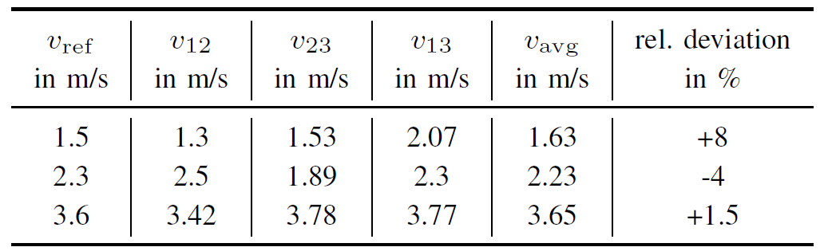
Measurement Results
Correlation Measurements
1.5 m/s
For avoiding cross correlation of offsets, usage of phase deviation
for cross correlation:
Velocity determination by
Diagram provides unequal velocity stepsize
Results
2.3 m/s
Average deviation: +1.8%
3.6 m/s
Notes:
In total 10 253 victims

Slide 33
Overview
Motivation
Sensor Concept
Design and Simulation
Measurement Results
Conclusion

Slide 34
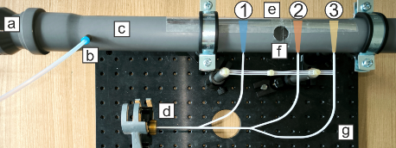
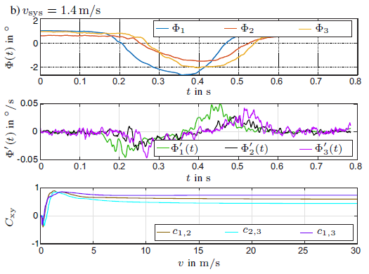
Conclusion
Gas flow metering can be challenging when safety regulations permit contact related measurement
Measurement history cross correlation of several mmW radar beams can is alternative measurement concept
For avoiding multiple radar devices, a DWG based signal distribution network was designed
Proposed concept relies on time multiplex and time gating measurements
Concept provides highest synchronity and accuracy
Measured flow velocities showed high accuray (1.8% deviation to reference)
Notes:
In total 10 253 victims

Slide 35
Thank you for your kind attention!
Contact:
Dr. Christoph Baer
Ruhr University Bochum
Christoph.Baer@rub.de

